Slide 1
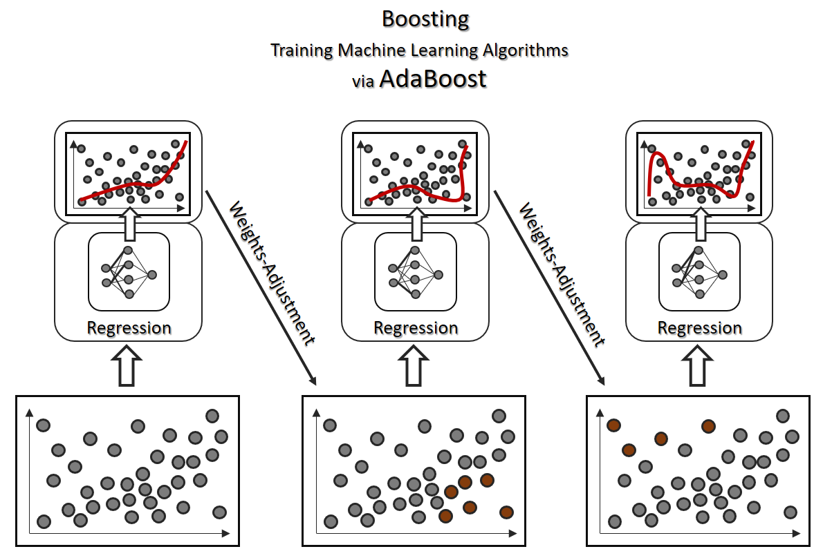
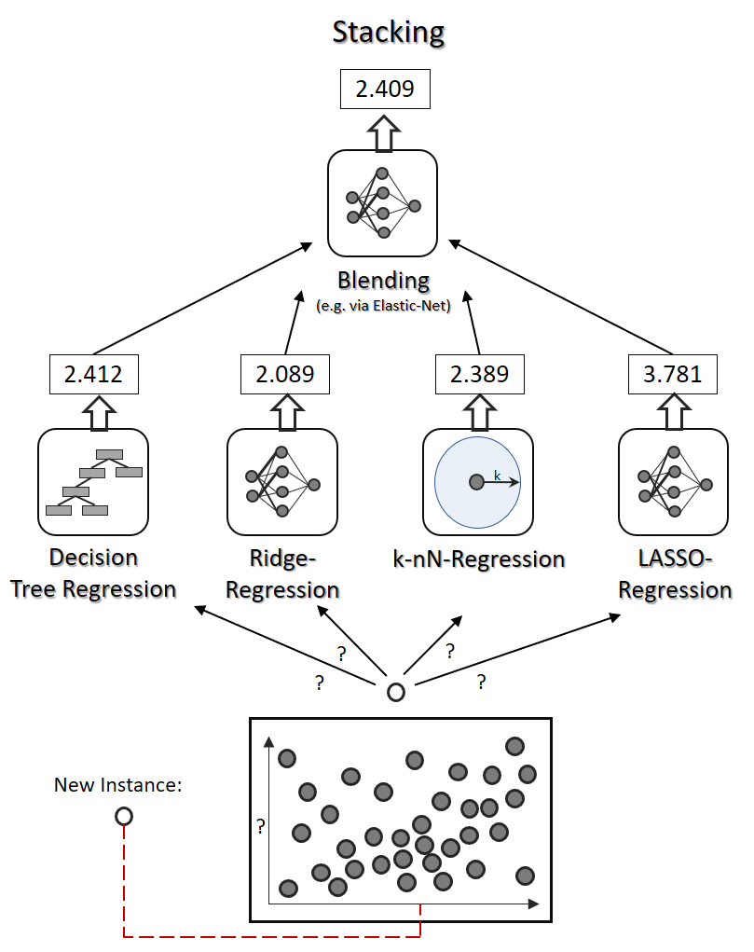
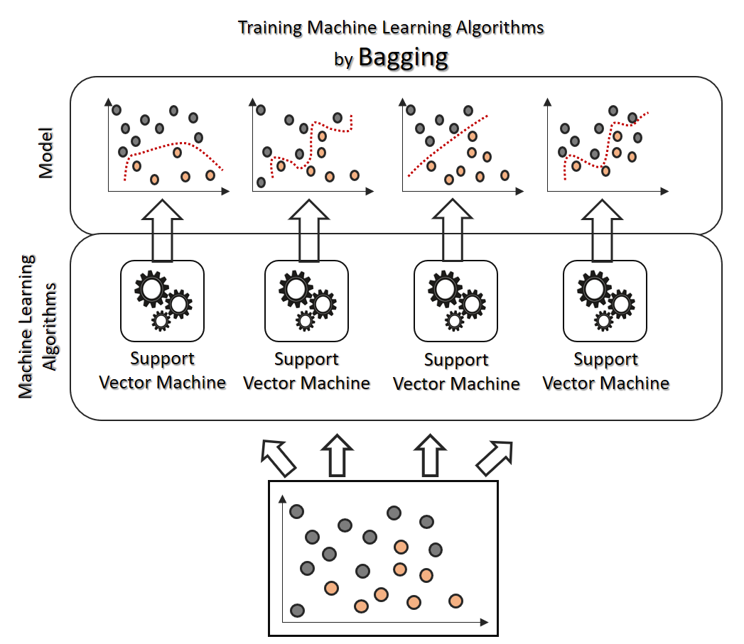
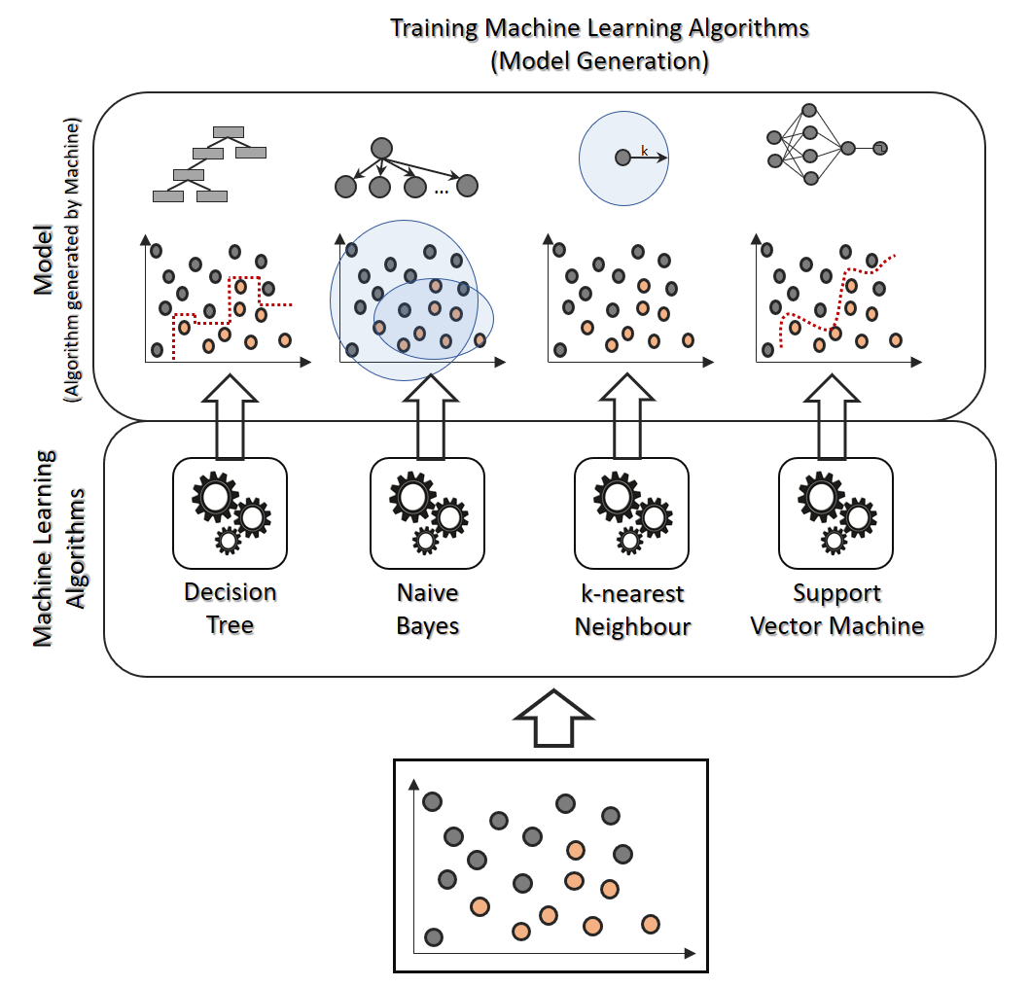
1.11957
Blending
(e.g. via linear regression)
Kaggle Scores:
1.08791
1.03403
1.01038
0.99843
1.03154
Linear
Regression
Random Forest
Regression
Gradient Boosting
Regression
Light Gradient Boosting
Regression
xgboost

Slide 4
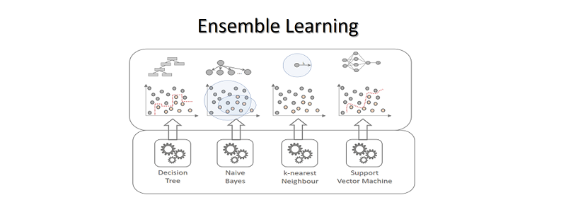

Slide 7
